Slide 1
Presentation: 2
Web and Mobile Development
By:
Affan Charolia- aacbb8@umsystem.edu
Aqdus Charolia- aacy5x@umsystem.edu
Video- https://youtu.be/jCUkF0Y9fM0
Github- https://github.com/Affancharolia/WebDevCourse/tree/main/ICP%20Presentation%202

Slide 2
ICP8: Login Page
Github: https://github.com/Aqdusc/WebDevCourse/tree/main/Mobile_Development/ICP8
Github: https://github.com/Affancharolia/WebDevCourse/tree/main/Mobile_Development/ICP8
Introduction: The goal of this ICP is to create a mobile application, which has the login page and when the user enters login and password as user, they get to the welcome page and when they click on the logout button, they get back to the login page.

Slide 3
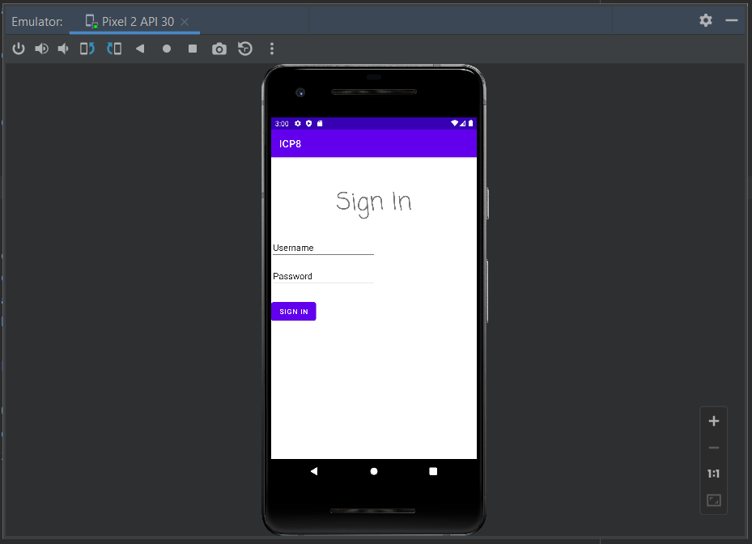
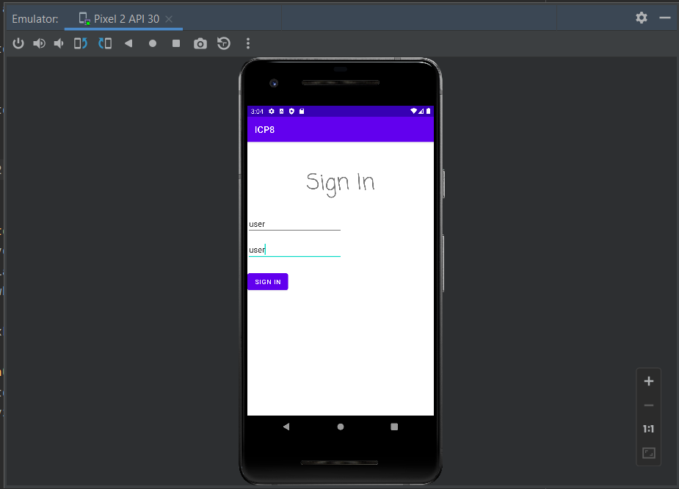
ICP8: Login Page
We create the MainActivity.java file to create a view. We create variables and link them to the fields using the id they are being assigned. When the fields are entered and submitted, the strings are matched with the string user and when matched, the toast function displays the title “you are entered the right way”. We then go to the next view using the intent function or if the value is incorrect, we display “value is not correct”

Slide 4
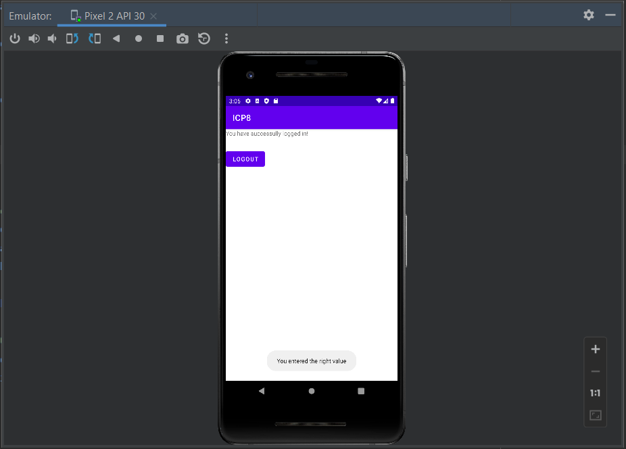
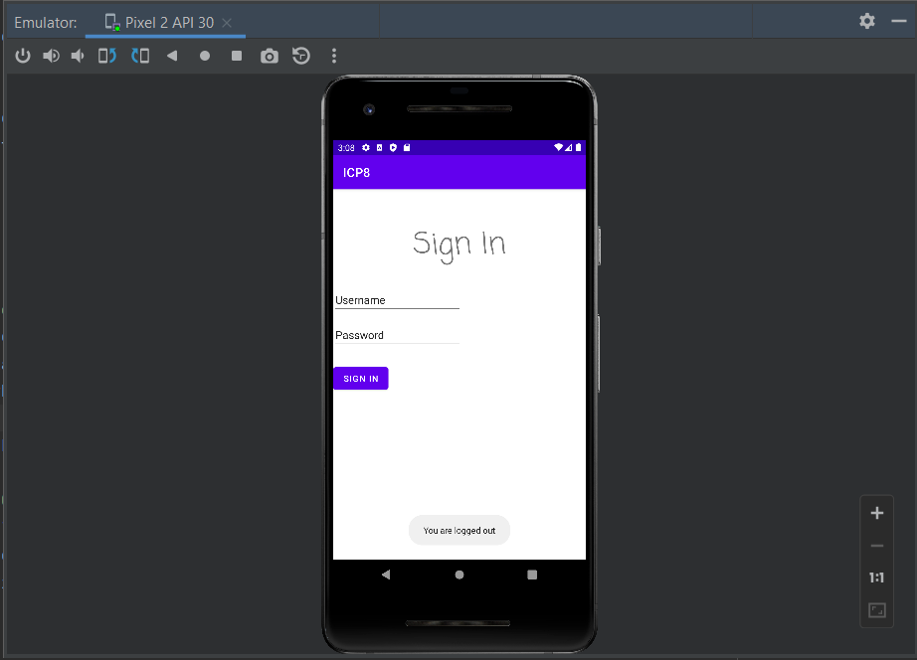
ICP8: Login Page
When we get to the welcome page, it displays the string and the logout button. On clicking the logout button we get to the login page, again,using the intent function along with the message displayed “You are logged out” string using the toast function.

Slide 5
ICP8: Login Page
Conclusion: We were able to create a login page which took in the inputs and when successful credentials were entered it took us to the welcome page with correct message being displayed on success and error. Further, on clicking the logout button we were able to go back to the login page with correct message being displayed.

Slide 6
ICP9: Pizza Ordering application
Github: https://github.com/Aqdusc/WebDevCourse/tree/main/Mobile_Development/ICP9
Github: https://github.com/Affancharolia/WebDevCourse/tree/main/Mobile_Development/ICP9
Introduction: The goal of this ICP is to create a pizza ordering mobile application which will allow the user to make some selection of their choice and they will be able to see their order summary and place the order which will get sent to them by mail.

Slide 7
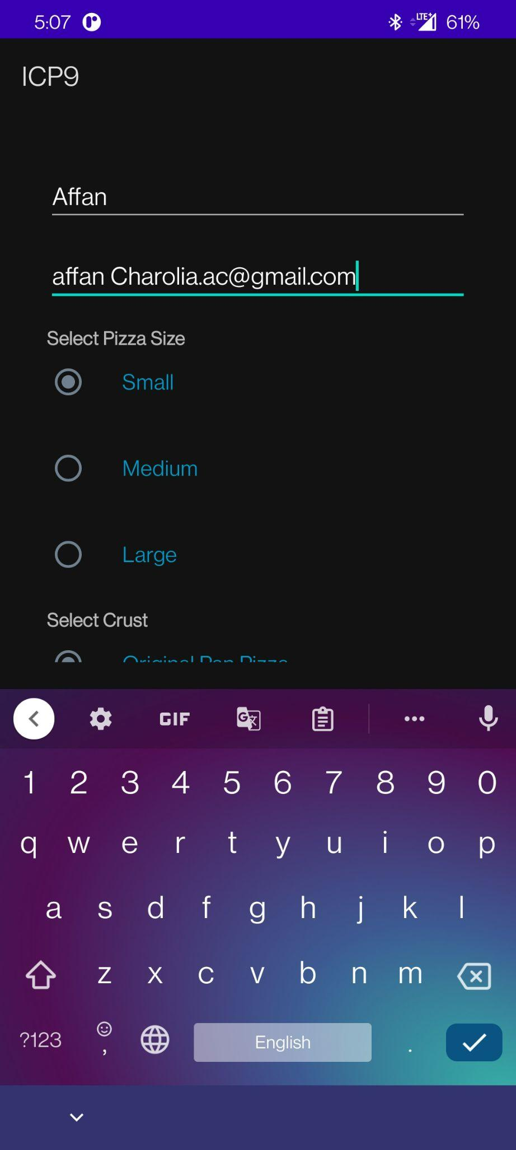
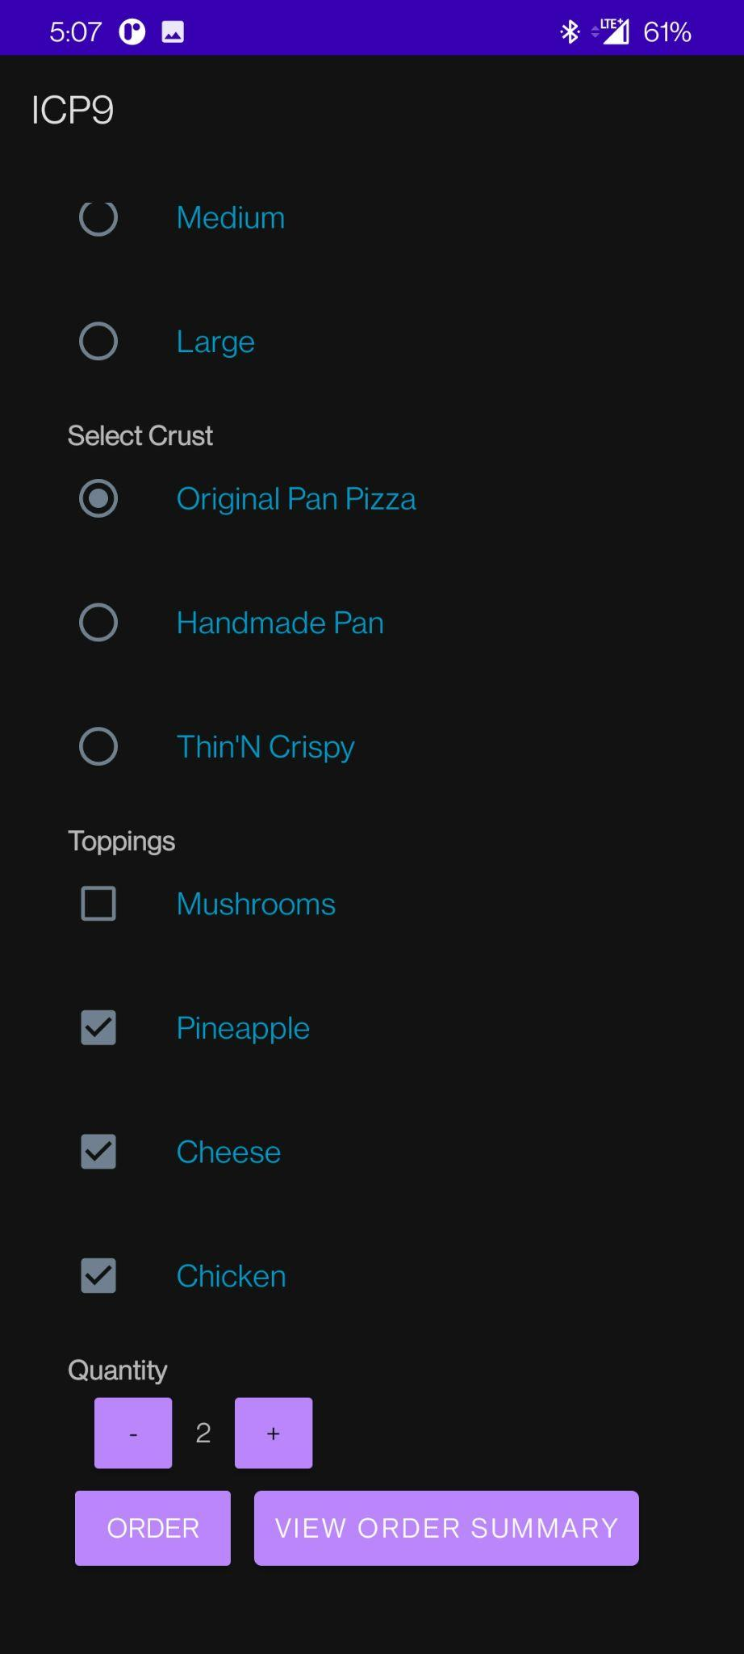
ICP9: Pizza Ordering application
Creating a linear layout, with a scroller, so that all the items will get arranged linearly.
Taking input for username and email address.
Select the crust of the pizza according to your choice.
Selecting the topping. Since it is a checkbox, you can select multiple options.
The user can select the quantity of pizza they want to order. They can increase or decrease the quantity using the buttons.
The user has two options to select. Either he can view the order summary or submit the order and receive the confirmation in the mail.

Slide 8
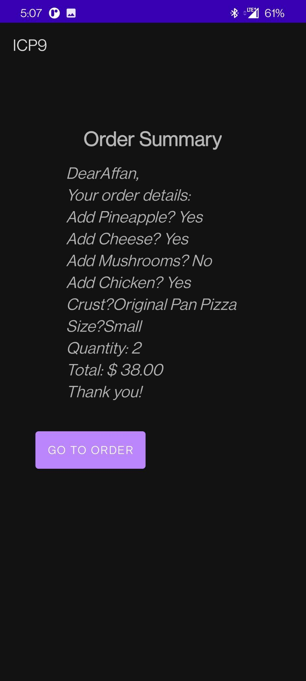
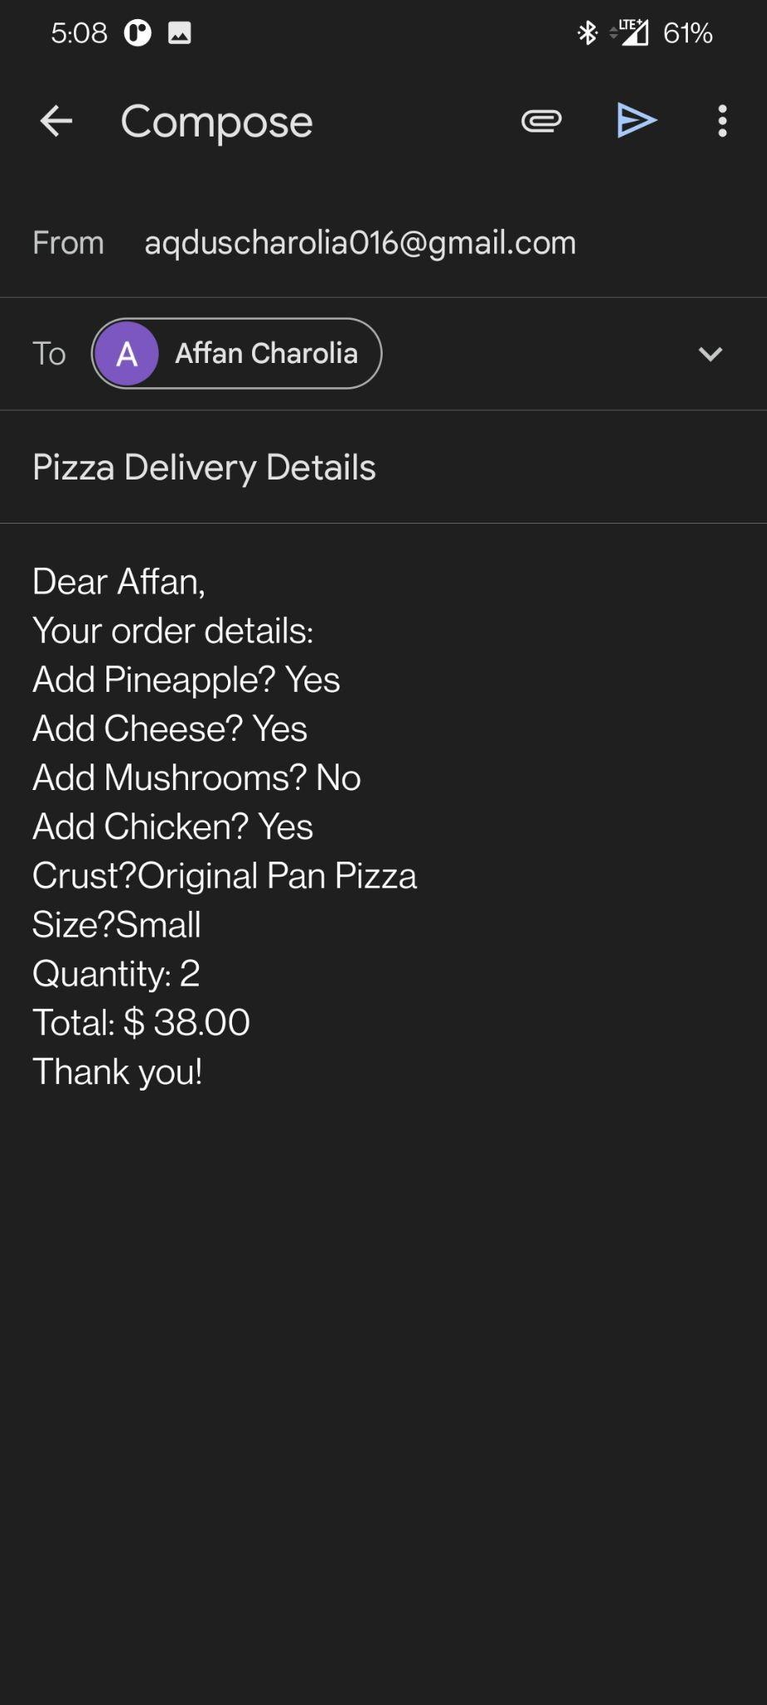
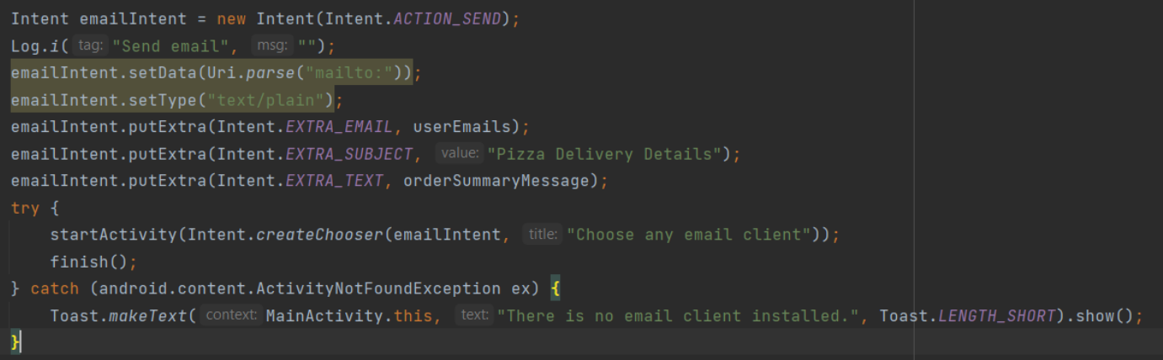
ICP9: Pizza Ordering application
Based on the selection the order summary is prepared.
Along with the order summary the price is also calculated for the pizza.
Once the order is verified you can click the “Go To Order” button.
On clicking the “Go To Order” button we go back on the main page.
On clicking the order button, we are taken to the email page using Intent function.

Slide 9
ICP9: Pizza Ordering application
Conclusion: We were able to create pizza ordering application where you can select the things you need on it and the quantity of pizza. Then the selections were displayed on the summary page along with the cost. The order placed is then sent to the user by email.

